Slide 1
Spring Committee Meeting Current Continuity in Auroral System Science: A 3D Modelling Approach to Current Closure in Non-Sheetlike Auroral Arcs
Jules van Irsel
Committee: Kristina Lynch, Yi-Hsin Liu, James Labelle, Matt Zettergren
April 26, 2023

Slide 2
Thesis Statement
The scope of this work will address the incomplete description of auroral arcs that stray from their basic, sheet-like morphology. The aim is to find physical, self-consistent solutions to the ionospheric current continuity equation, Eq. (7), using state-of-the-art ionospheric 3D modelling to provide insight into the role the ionosphere plays in MI coupling for less idealized auroral events. In particular, knowing the portions of FAC closed by Pedersen currents, which produce collisional Joule heating, versus Hall currents, which are non-dissipative, gives insight into the extent to which the ionosphere acts as a load to a magnetospheric generator. Secondary to this, the extent to which inductive MI coupling effects this electrostatic picture will be investigated.

Slide 3
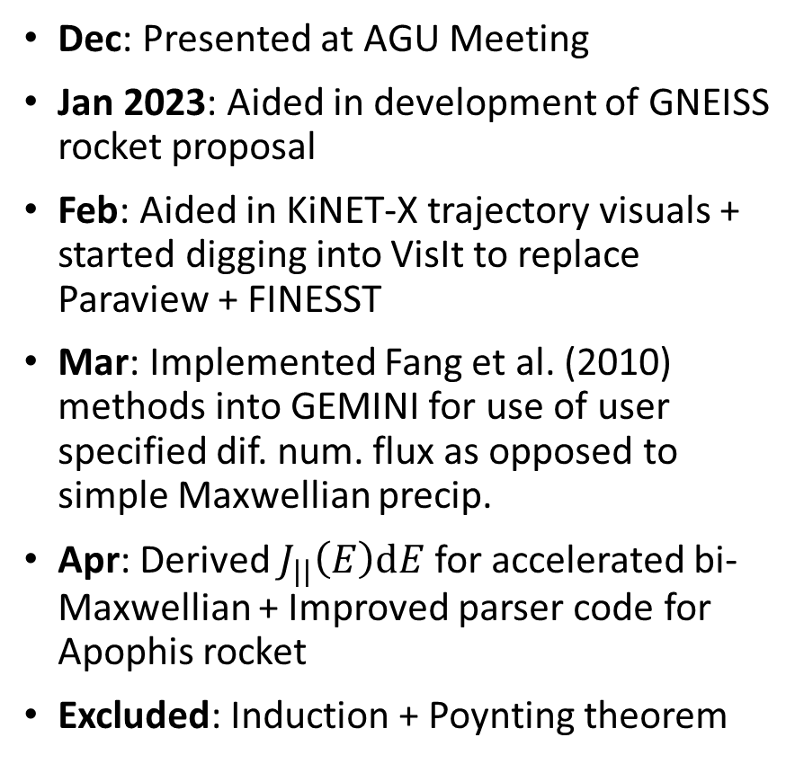

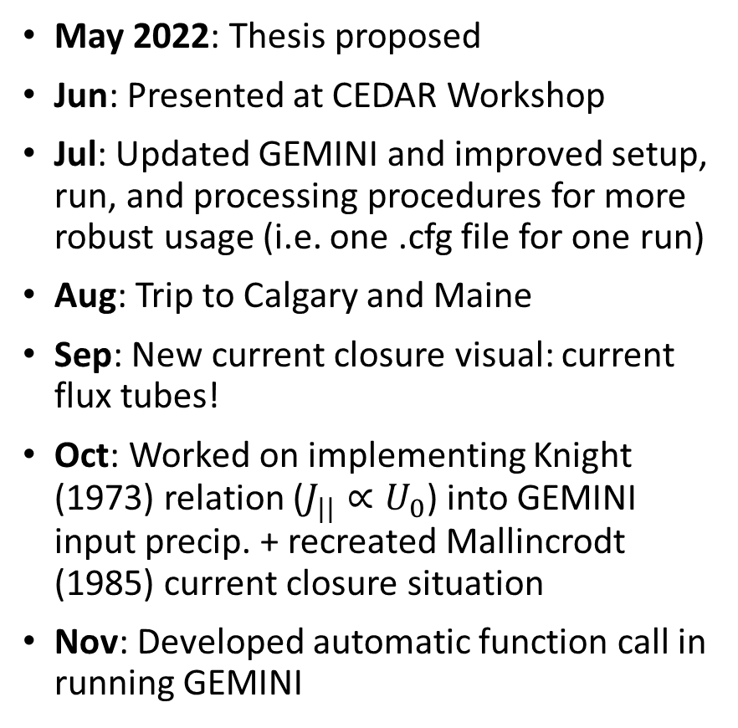


Progress Summary
May 2022: Thesis proposed
Jun: Presented at CEDAR Workshop
Jul: Updated GEMINI and improved setup, run, and processing procedures for more robust usage (i.e. one .cfg file for one run)
Aug: Trip to Calgary and Maine
Sep: New current closure visual: current flux tubes!
Oct: Worked on implementing Knight (1973) relation ($J_{||}∝U_{0}$) into GEMINI input precip. + recreated Mallincrodt (1985) current closure situation
Nov: Developed automatic function call in running GEMINI
Dec: Presented at AGU Meeting
Jan 2023: Aided in development of GNEISS rocket proposal
Feb: Aided in KiNET-X trajectory visuals + started digging into VisIt to replace Paraview + FINESST
Mar: Implemented Fang et al. (2010) methods into GEMINI for use of user specified dif. num. flux as opposed to simple Maxwellian precip.
Apr: Derived $J_{||}\left(E\right)dE$ for accelerated bi-Maxwellian + Improved parser code for Apophis rocket
Excluded: Induction + Poynting theorem

Slide 4
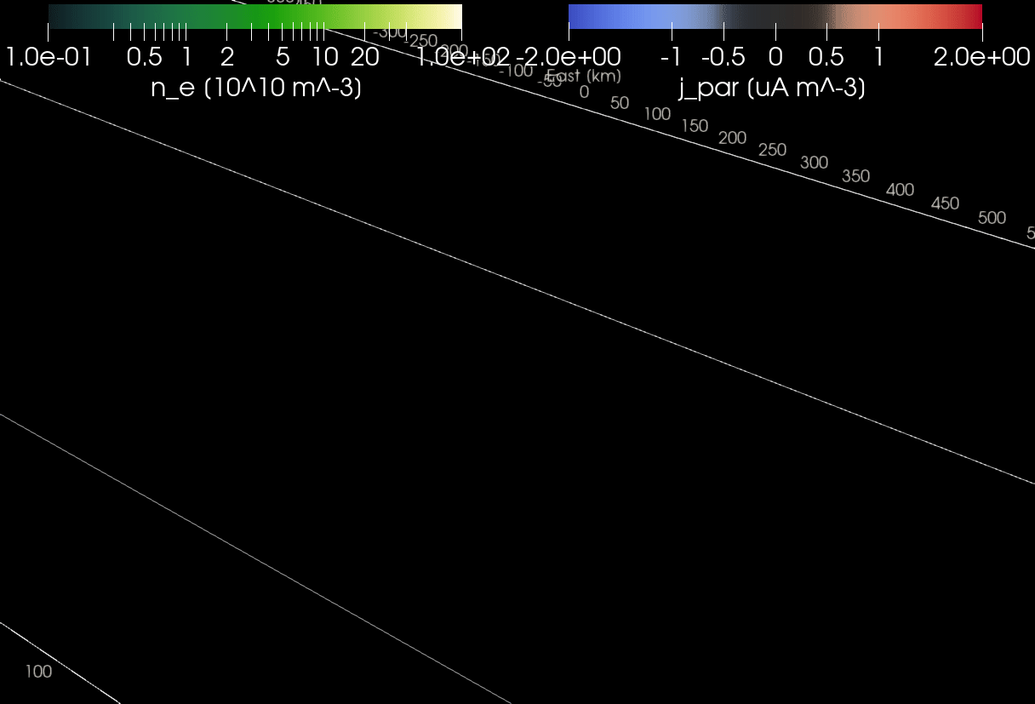
Visualizing 3D FAC closure is hard

Slide 5
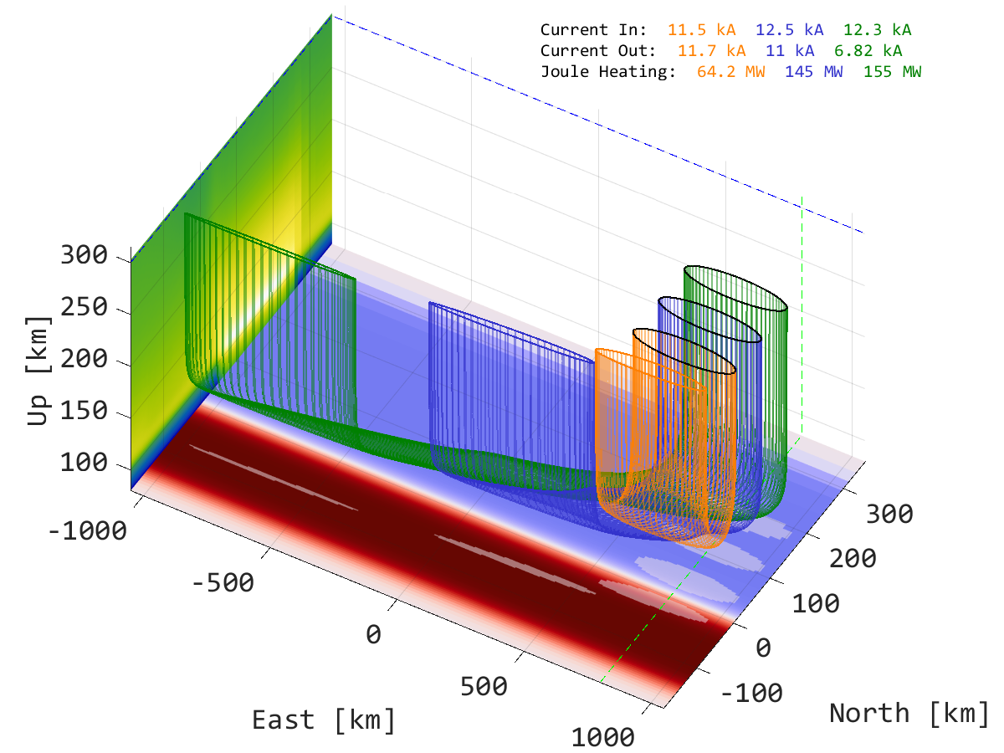
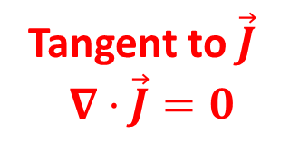
ish
Same J flux
Streamline source
points on closed curve
Tangent to $\vec{J}$
$$∇⋅\vec{J}=0$$

Slide 6
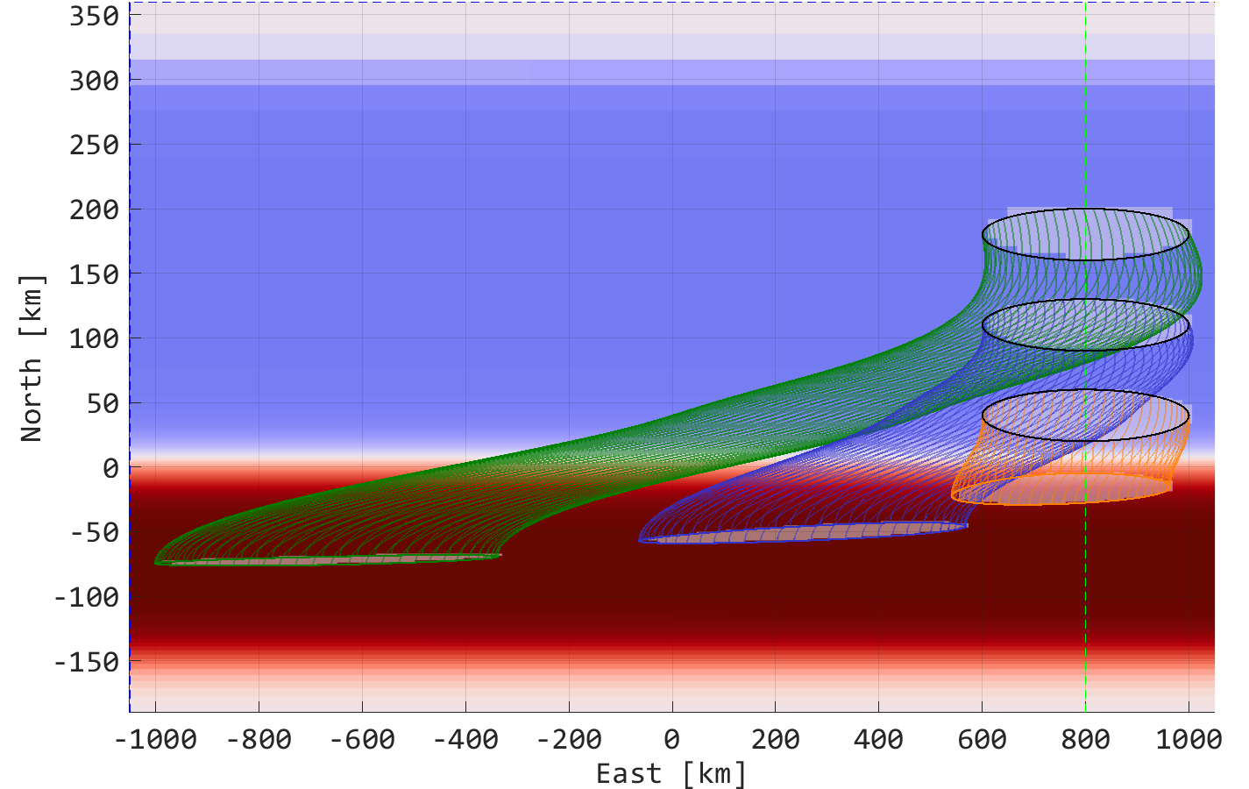

Slide 7
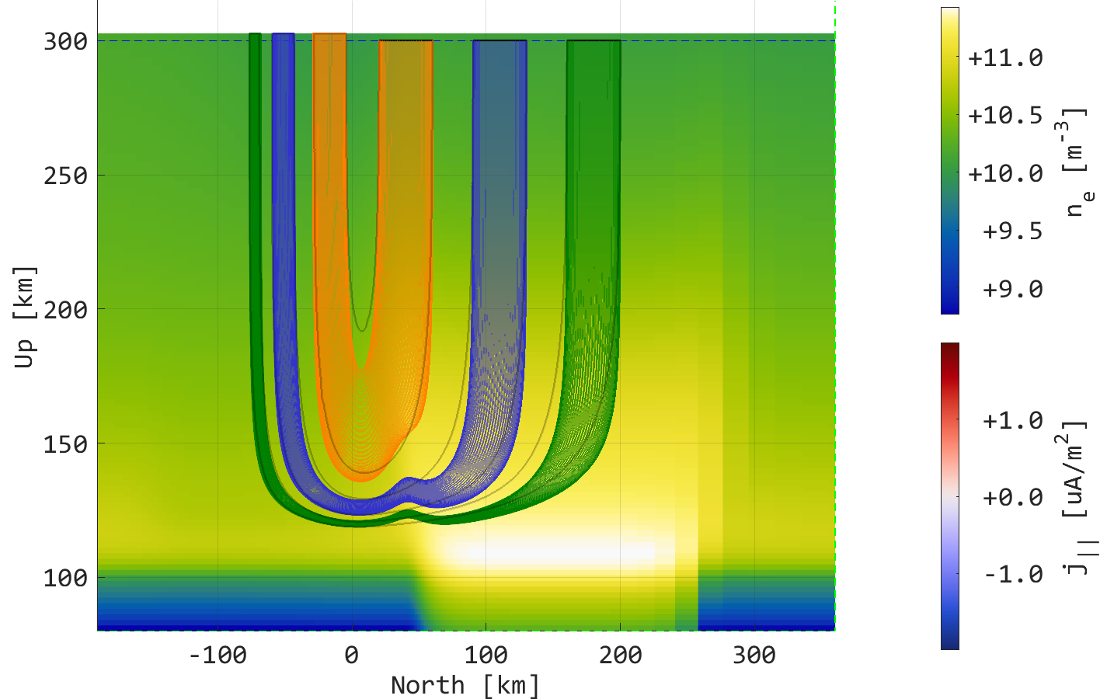

Slide 8
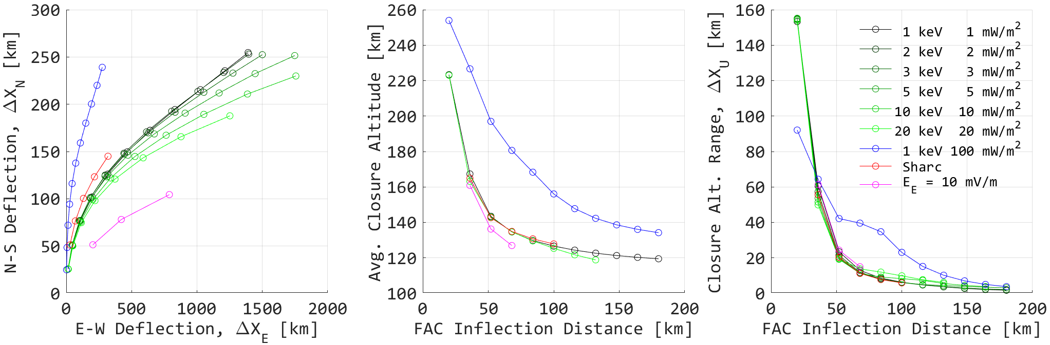

Slide 9
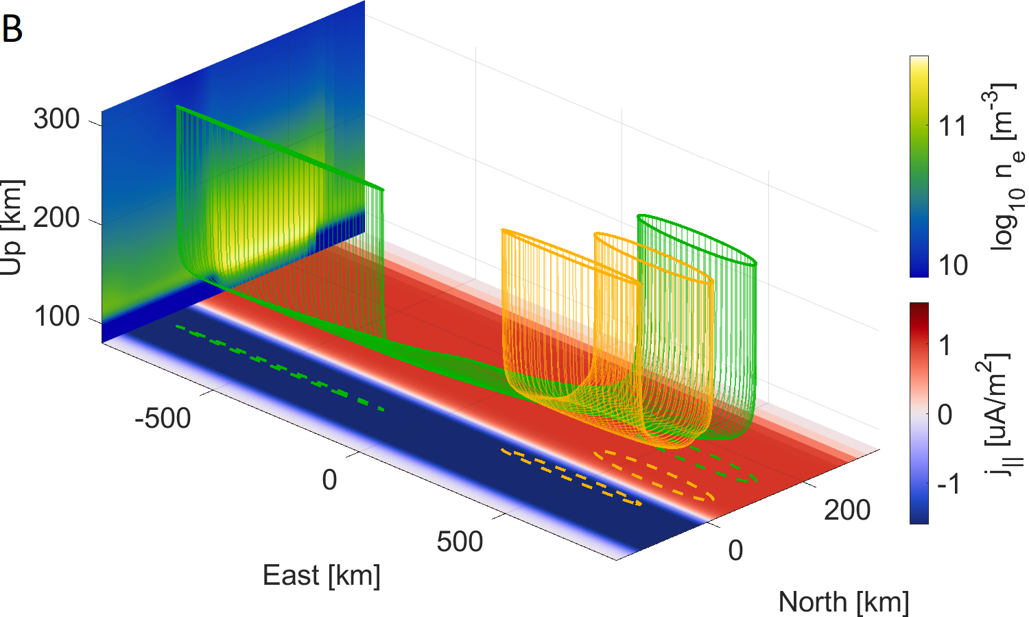

Slide 10
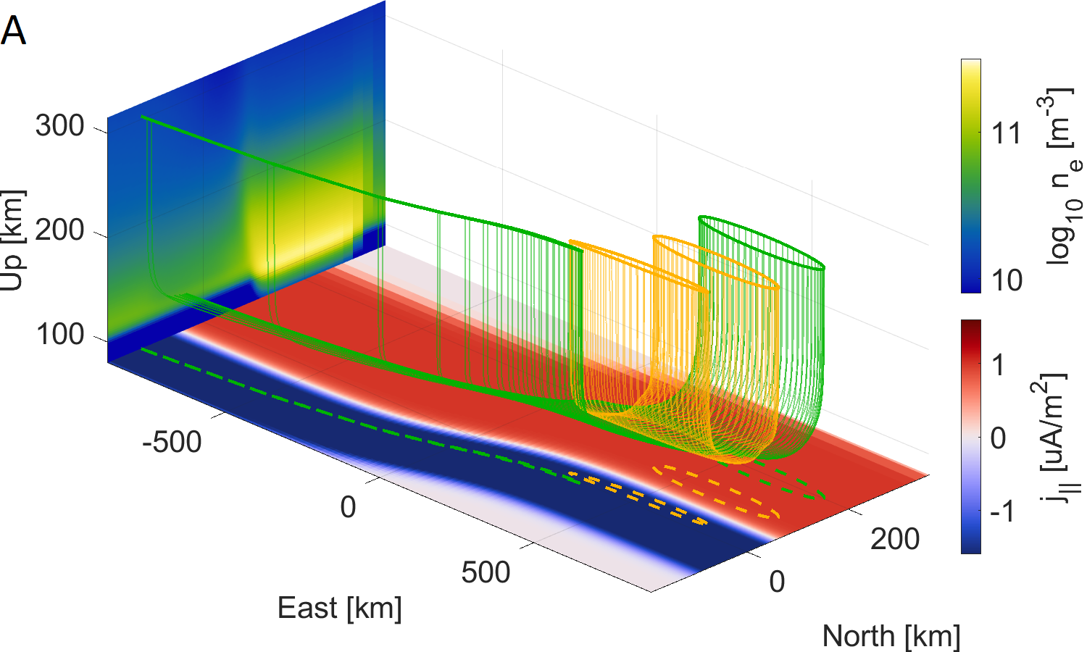

Slide 11
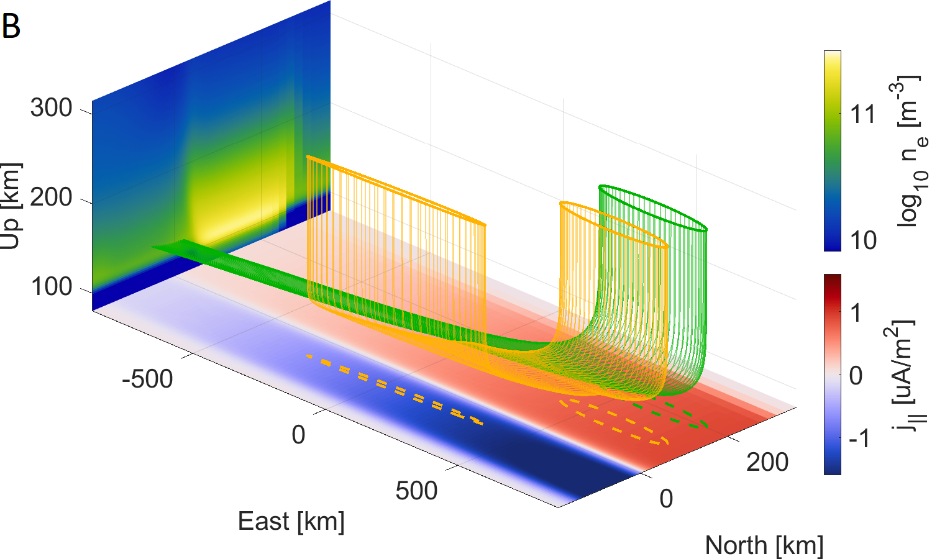

Slide 12
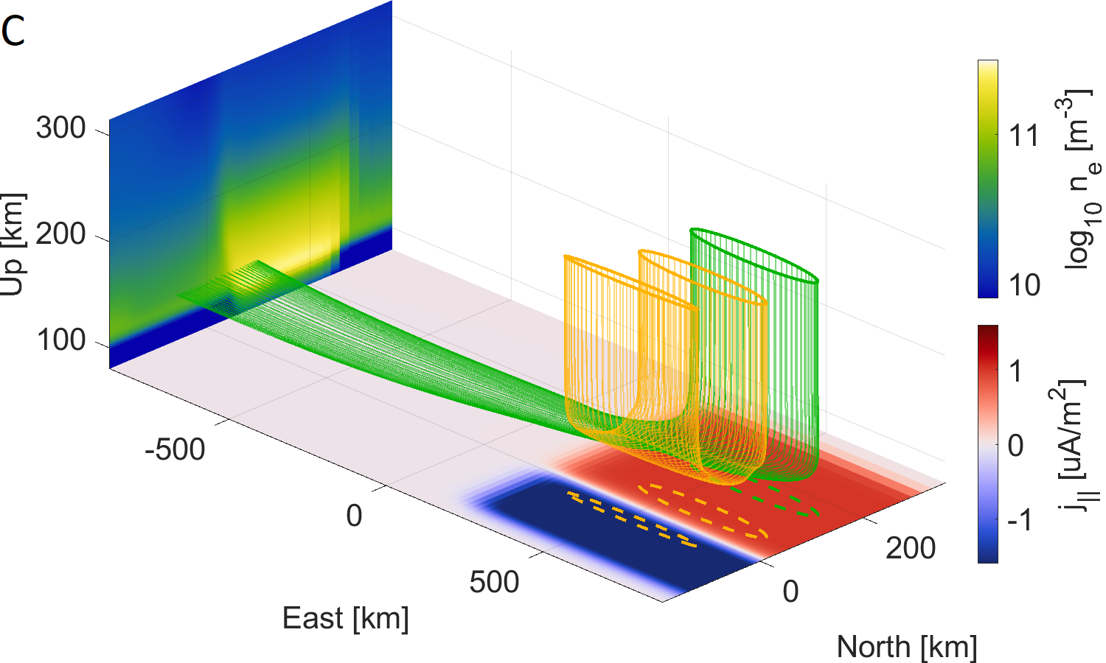

Slide 13
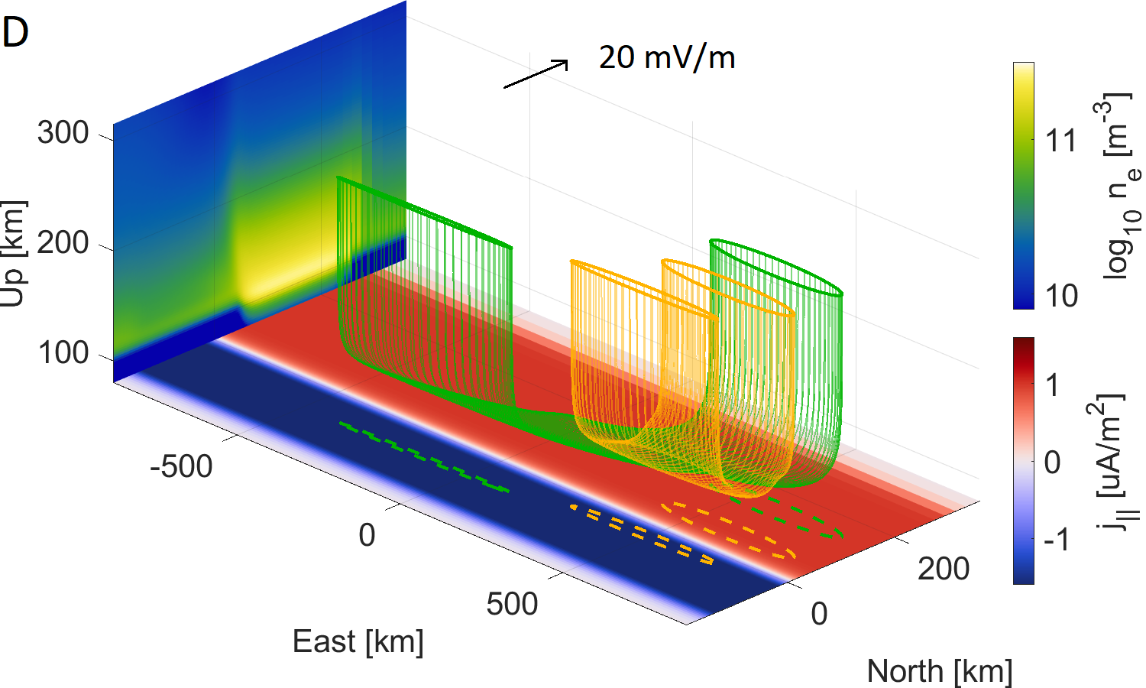

Slide 14
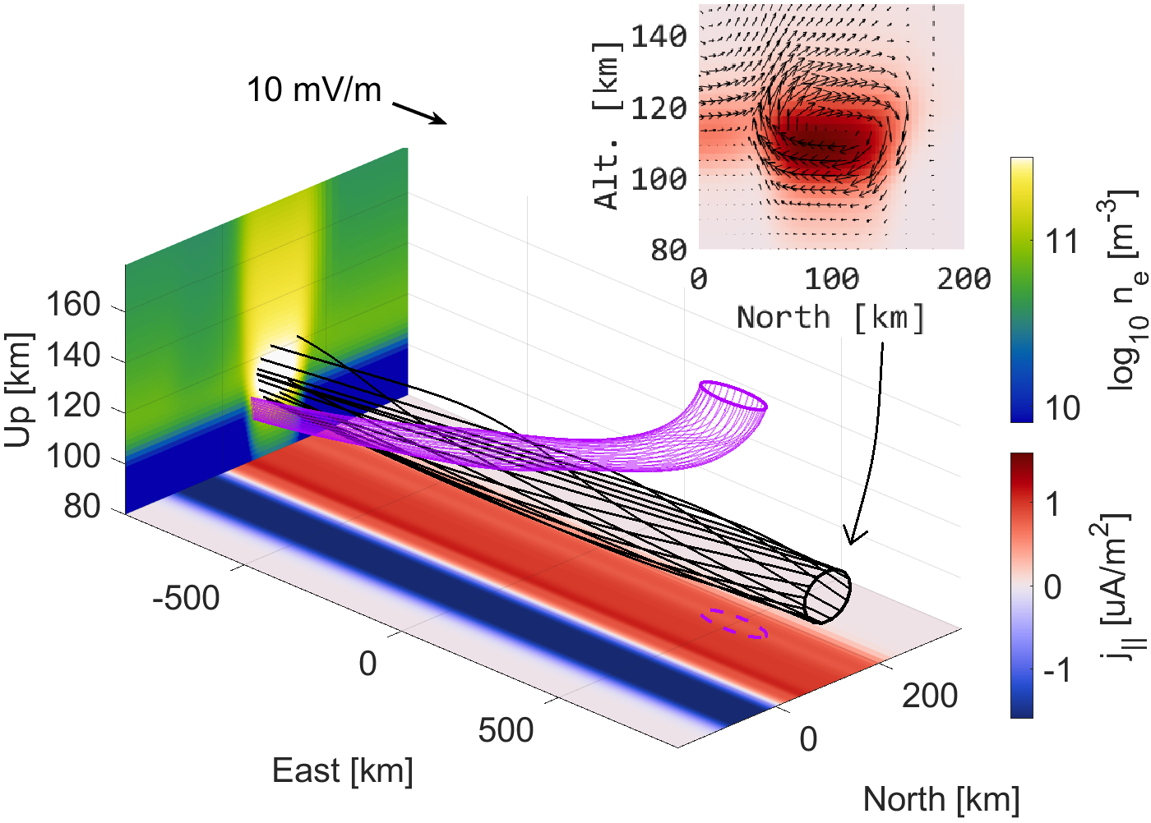

Slide 15
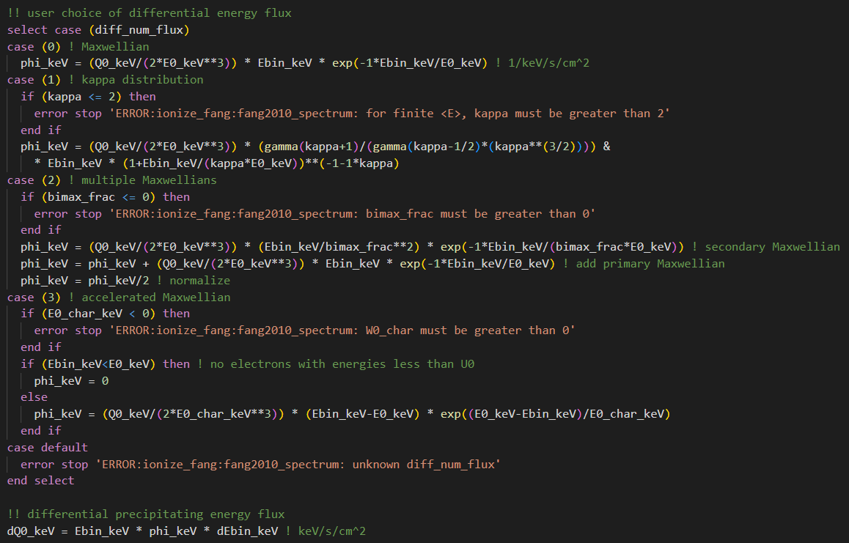

Slide 16
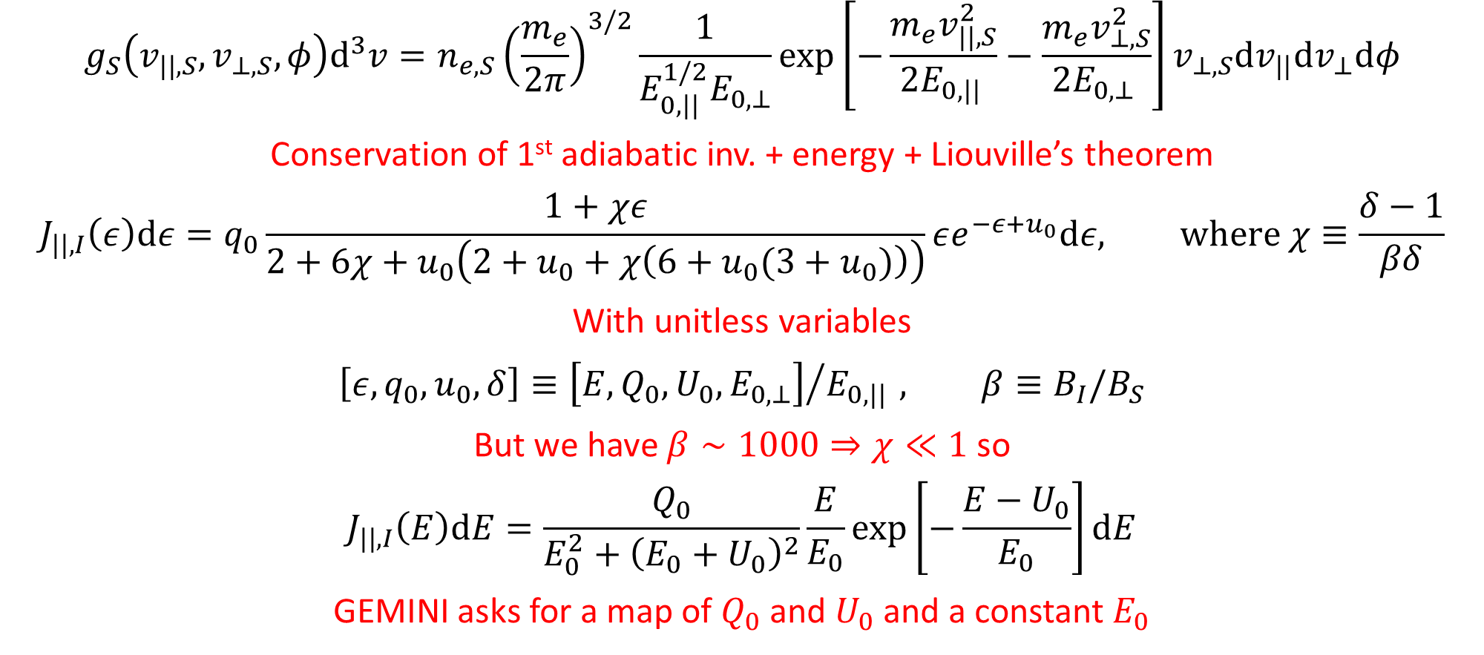
The math slide
$$g_{S}\left(v_{||,S},v_{⊥,S},φ\right)d^{3}v=n_{e,S}{\left(\frac{m_{e}}{2π}\right)}^{3/2}\frac{1}{E_{0,|| }^{1/2}E_{0,⊥}}\exp\left[−\frac{m_{e}v_{||,S}^{2}}{2E_{0,|| }}−\frac{m_{e}v_{⊥,S}^{2}}{2E_{0,⊥ }}\right]v_{⊥,S}dv_{||}dv_{⊥}dφ$$
Conservation of 1st adiabatic inv. + energy + Liouville’s theorem
$$J_{||,I}\left(ε\right)dε=q_{0}\frac{1+χε}{2+6χ+u_{0}\left(2+u_{0}+χ\left(6+u_{0}(3+u_{0})\right)\right)}εe^{−ε+u_{0}}dε, where χ≡\frac{δ−1}{βδ}$$
With unitless variables
$$\left[ε,q_{0},u_{0},δ\right]≡{\left[E,Q_{0},U_{0},E_{0,⊥}\right]}/{E_{0,|| }}, β≡B_{I}/B_{S}$$
But we have $β∼1000⇒χ≪1$ so
$$J_{||,I}\left(E\right)dE=\frac{Q_{0}}{E_{0}^{2}+{\left(E_{0}+U_{0}\right)}^{2}}\frac{E}{E_{0}}\exp\left[−\frac{E−U_{0}}{E_{0}}\right]dE$$
GEMINI asks for a map of $Q_{0}$ and $U_{0}$ and a constant $E_{0}$

Slide 17
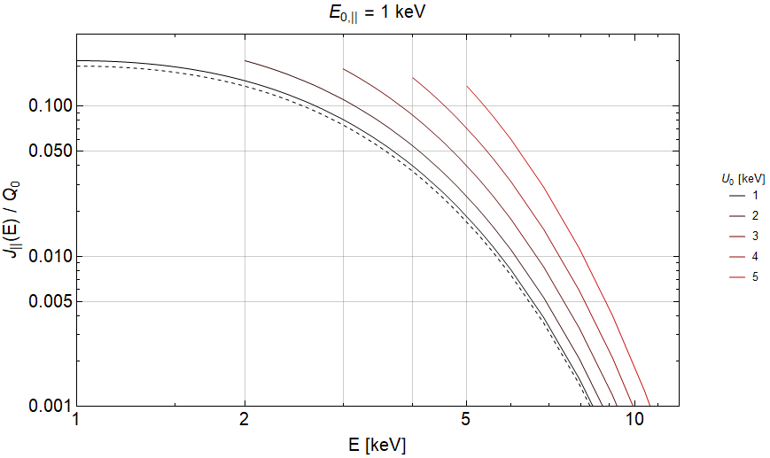
1
1

Slide 18
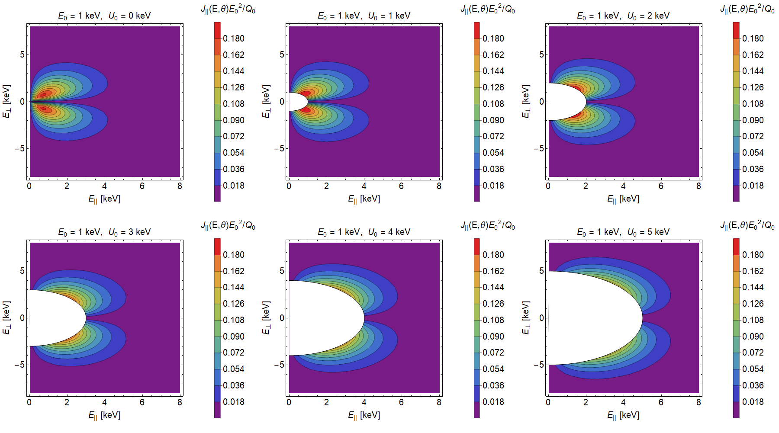

Slide 19
Future work
Before Aug 2023
Add low energy tail to acc. Maxwellian through Evans (1974) or Meier (1989)
Push request new GEMINI code snippets to public
Write paper on 3D morphology findings
Aug 2023 – Aug 2024
Run ~1000 of GEMINI runs (10 categories x 10 parameters/category x 10 values per parameter)
Further develop tools for analyzing morphological parameters
Submit a paper on findings
Aug 2024 – Aug 2025
Gather and setup GEMINI to run with data drivers (DASC + rockets + SWARM)
Submit a paper on findings

Slide 20
